Slide 1
Hammonds Farm is “The Preferred Choice”
Now what?

Slide 2
The Parish Councils of –
Little Baddow
Danbury
Sandon
Boreham
ALL OBJECT TO WHAT IS PROPOSED.
The aim of this meeting is to –
- tell you what that proposal is, and
- explain some of the reasons for their objection, and
- help you to join them in objecting, if you agree.

Slide 3
For you, this means –
this time, writing a separate letter of objection
including factual reasons why the plan is a bad one, choosing from what we tell you which bits matter most to you
Sending your -
Email by 16th June,
or letter by 14th June (1st class post).
Email and post addresses will be put on the website:
“notohammondsfarm.co.uk”
But you can anyway pick up a paper slip as you leave.

Slide 4
If, after hearing about the proposal tonight,
you want help as to what to say then go to –
www.notohammondsfarm.co.uk/submission-form
For words, phrases, important points of objection
And build your own letter

Slide 5
We DON’T recommend that you try to send in your comments using the City Council online portal.
This is because it –
requires you to identify each “section/policy/ paragraph/table/figure/appendix/Policies Map” on which you are commenting
times out so you lose your input if you are not quick enough.

Slide 6
The Proposal
3000 houses by 2041 – the current size of Beaulieu Park, or not much less than the current size of Danbury, Sandon and Little Baddow combined -77% of the total required
43000sqm of “employment space” in Hammonds in addition to a similar amount nearby - together, 52% of the total required
A new arterial road leading from Hammonds to Boreham Interchange
“mitigation” proposals to reduce congestion arising on the A414 at the junction with the A12
A “bus, cycle and footway” bridge over the A12
A “Small reduction in trips along the A414” caused by displacement onto alternative routes” in other words, more rat-running through ALL of our villages, acknowledged in the modelling.

Slide 7
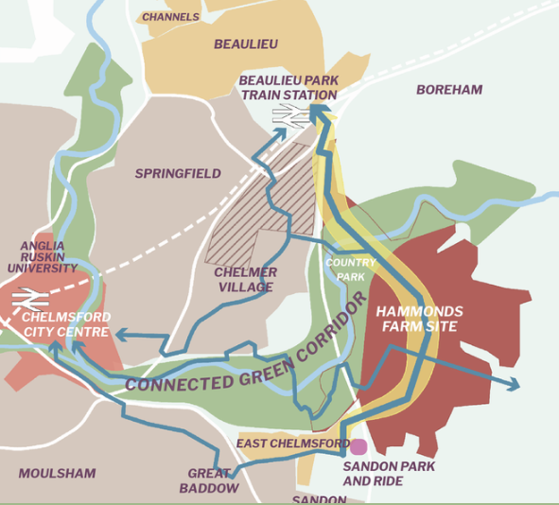
The Proposal
New
Road
A12

Slide 8
Work in Progress
We have only just become aware of this new highways proposal, and are commissioning specialist
Highways Consultants to review the extensive and complex detail.
Initial reaction?
Proposal has substantial potential effects upon –
The A12 between A414 and Boreham exit; and
The ability of Boreham Interchange to handle its load
We hope to quantify this issue before consultation closes.

Slide 9
Meanwhile, why is the Preferred Option
A bad plan?

Slide 10
Chelmsford must allocate land for houses and employment – why is Hammonds a bad plan?
1. The appears to be no need for a new “Garden Community”
In Autumn, 5 options to deliver 8000 houses –
every one had minimum 3000 extra houses in North East Chelmsford
Every one had minimum 1000 extra houses on brownfield sites
Now the need is reduced by over-provision to 3862 homes, which can be wholly delivered without having to start a wholly new greenfield community.
The consultation document does not explicitly
consider this possibility

Slide 11
Chelmsford must allocate land for houses and employment – why is Hammonds a bad plan?
It has been suggested informally to us that Hammonds can be developed more quickly than other sites.
There is no need for urgency – the extra houses are needed by 2041
The highways infrastructure needs will be extensive – and will be needed before the houses are built, not afterwards.
There are mineral extraction possibilities at Beaulieu, but they can be extracted easily within the existing plan, long before the houses are needed
Training GPs takes 10 years and there aren’t enough available (or affordable) locally, so the extra houses should be phased in slowly anyway.

Slide 12
Chelmsford must allocate land for houses and employment – why is Hammonds a bad plan?
Highways’ changes are needed to support a development at Hammonds that are much more significant than elsewhere -
A12 J18-19 can’t cope, no plans to widen
A414 at J18 is a pinch point, “mitigation” is needed, currently speculative and poorly defined, requires new bridge
Arterial from Hammonds to Boreham Interchange will take several years
Boreham Interchange will require further development, operational capacity still unclear,
impact of Boreham Rail Station uncertain.
Highways implications of development elsewhere not publicly reviewed and likely to be materially less.

Slide 13
Chelmsford must allocate land for houses and employment – why is Hammonds a bad plan?
Even current proposal not properly developed. For example CCC’s assessment:
“Critical….should be a requirement to ensure background traffic flows along A414 not unreasonably delayed…This may well require significant highway measures in the vicinity”
“Analysis of model outputs forecasts a potential capacity issue with the Beaulieu Parkway bridge link ….It is
recommended that delays along the route are monitored… to determine the long-term viability of the route

Slide 14
These statements appear in an impact assessment -
“Proposed development along the A12 corridor has the potential to route a significant proportion of trips via the A12 - both northbound and southbound – from Junction 18, thereby exacerbating congestion along the trunk road. Modelling suggests this will also increase the likelihood of traffic re-routing along rural roads to the east of the A12, impacting the villages of Boreham and Little Baddow.”
“A12 carriageway widening between Junctions 15-19 is not considered in National Highways’ Road Investment Strategy (RIS3) pipeline for the period 2025-2030, and it is not clear whether National Highways are considering carriageway improvements beyond this period”
What about non-highways’ issues?

Slide 15
Chelmsford must allocate land for houses and employment – why is Hammonds a bad plan?
4. Flood risk TO housing and FROM Housing –
Impact of climate change on flood plain yet to be reviewed
Impact of displacement of water following housing development yet to be modelled
Need to allow flood water from central Chelmsford to flow more freely to valley of Navigation, yet to be reviewed/understood
Flooding NOT a problem at alternative sites

Slide 16
Chelmsford must allocate land for houses and employment – why is Hammonds a bad plan?
5. Foul water treatment –
Work in progress
We do not yet know how foul water will in the event be treated
Existing facility currently inadequate
Concern that any overspill will inevitably find its way into Chelmer & Blackwater
This would not be the case at North East Chelmsford

Slide 17
Chelmsford must allocate land for houses and employment – why is Hammonds a bad plan?
6. Land Usage -–
Work in progress
Hammonds is mainly Graded 3 for land quality
If 3a then this is of good farming quality – central government has policies to protect good land from “significant, inappropriate or unsustainable development…”
CCC was under the impression that Hammonds was potentially Grade 3b and partly Grade 4.
We aim to correct that.

Slide 18
Chelmsford must allocate land for houses and employment – why is Hammonds a bad plan?
7. Environmental Destruction –
New arterial road is through a beautiful, rural valley
Application submitted to create the area as an “Area of Outstanding Natural Beauty” –now renamed “National Landscape”
Buildings, bridges and roads will destroy wildlife corridors, and the EWT corridor project
Sewerage farm overspills into The Chelmer and Blackwater Navigation would have consequent destruction of wildlife
Continued…

Slide 19
Chelmsford must allocate land for houses and employment – why is Hammonds a bad plan?
7. Environmental Destruction –
Landscape Capacity and Sensitivity Assessment 2017 said site has: “a high overall landscape sensitivity rating and a low to medium landscape capacity rating”
A proportion of the site is also identified by the existing Chelmer and Blackwater Navigation Landscape Conservation Area designation.
None of which is needed if development continues to be focused in North east Chelmsford

Slide 20
Chelmsford must allocate land for houses and employment – why is Hammonds a bad plan?
8. Archeological/Historical/Heritage –
Work in progress
Location of Roman settlements
Historical head of navigation
No such concerns in North East Chelmsaford

Slide 21
Chelmsford must allocate land for houses and employment – why is Hammonds a bad plan?
8. And what will be created? –
Supposedly a “Garden Community”
But one that is split by a major arterial through its centre, “detached from the existing urban area and accessibility to key services” (CCC, 2017)
With much of its open space vulnerable to flooding and climate change
With existing rainwater displaced to exacerbate flooding issues
Creating major congestion for local roads and interchanges
And adding to congestion on the A12
Instead of adding to the existing community being created in North East Chelmsford

Slide 22
OK, so if Hammonds is such a bad plan,
Why might Chelmsford be proposing it?
We are trying to find out

Slide 23
We would like you to object
Email and post addresses will be put on the website:
“notohammondsfarm.co.uk”
and are available as you leave tonight.
But you don’t have to do it unaided.
Guidelines and ideas available on our website
www.notohammondsfarm.co.uk/submission-form
Email by 16th June or letter by 14th June (1st class post).

